Slide 1



DATA SCIENCE TRACK
GROUP 14: JINQ-CHING VUONG – JOHANNA PASSLICK – JULIUS PAULEIT – THEA ÖCKERFELT – VIKESH SUBRAMONIAM

Slide 2
THE PROBLEM
Human Society of United States Data and American Society for the Prevention of Cruelty to Animals:
3 million cats and dogs euthanized in shelters each year
approximately 3.2 million shelter animals are adopted each year
40% of dog owners and 46% of cat owners learned about their pet through word of mouth*
We use modern technology to connect an ownerless pet to a new loving home more effectively
* www.americanpetproducts.org

Slide 3
MENTAL HEALTH
Amid this Covid-19 and lockdown times, living alone during this uncertain times for a prolonged period brings up emotions like:
🥱 😐 🥺
boredom depression loneliness

Slide 4
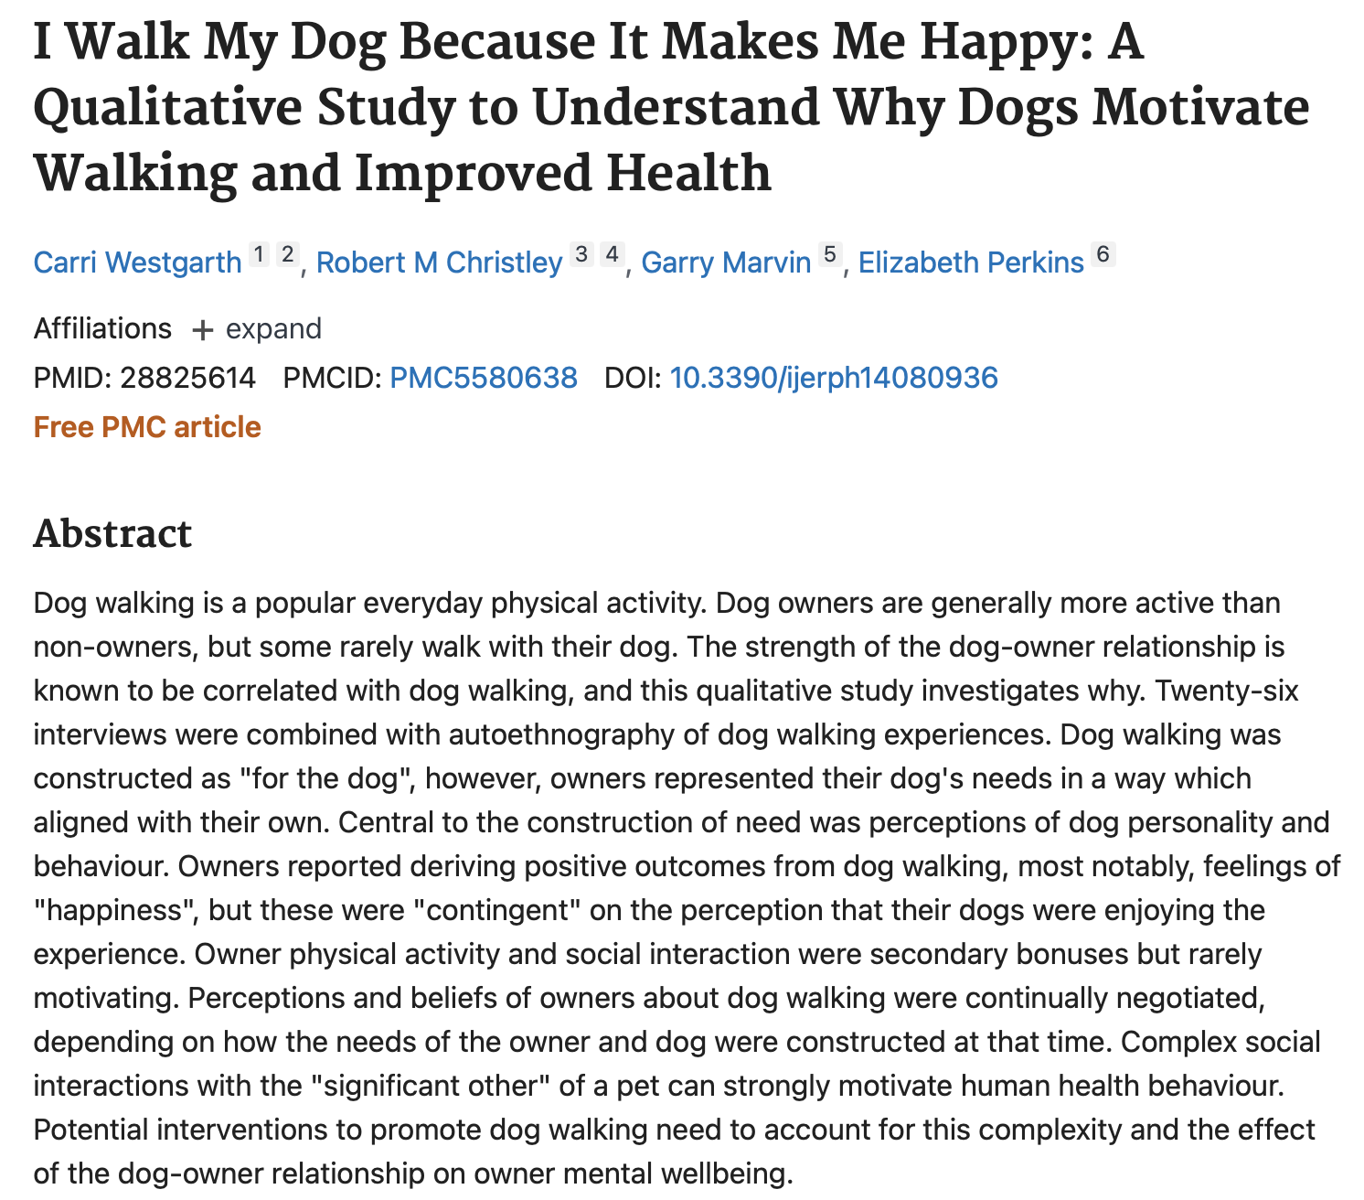
HAPPINESS
Scientific Research proves that: → Playing with a dog or cat can elevate levels of serotonin and dopamine.
To bring happiness to both animals and humans, we as a team created PetMatch.
Basically we created a platform to match pets of their choice with the users/customers who are ready to adopt one.

Slide 5
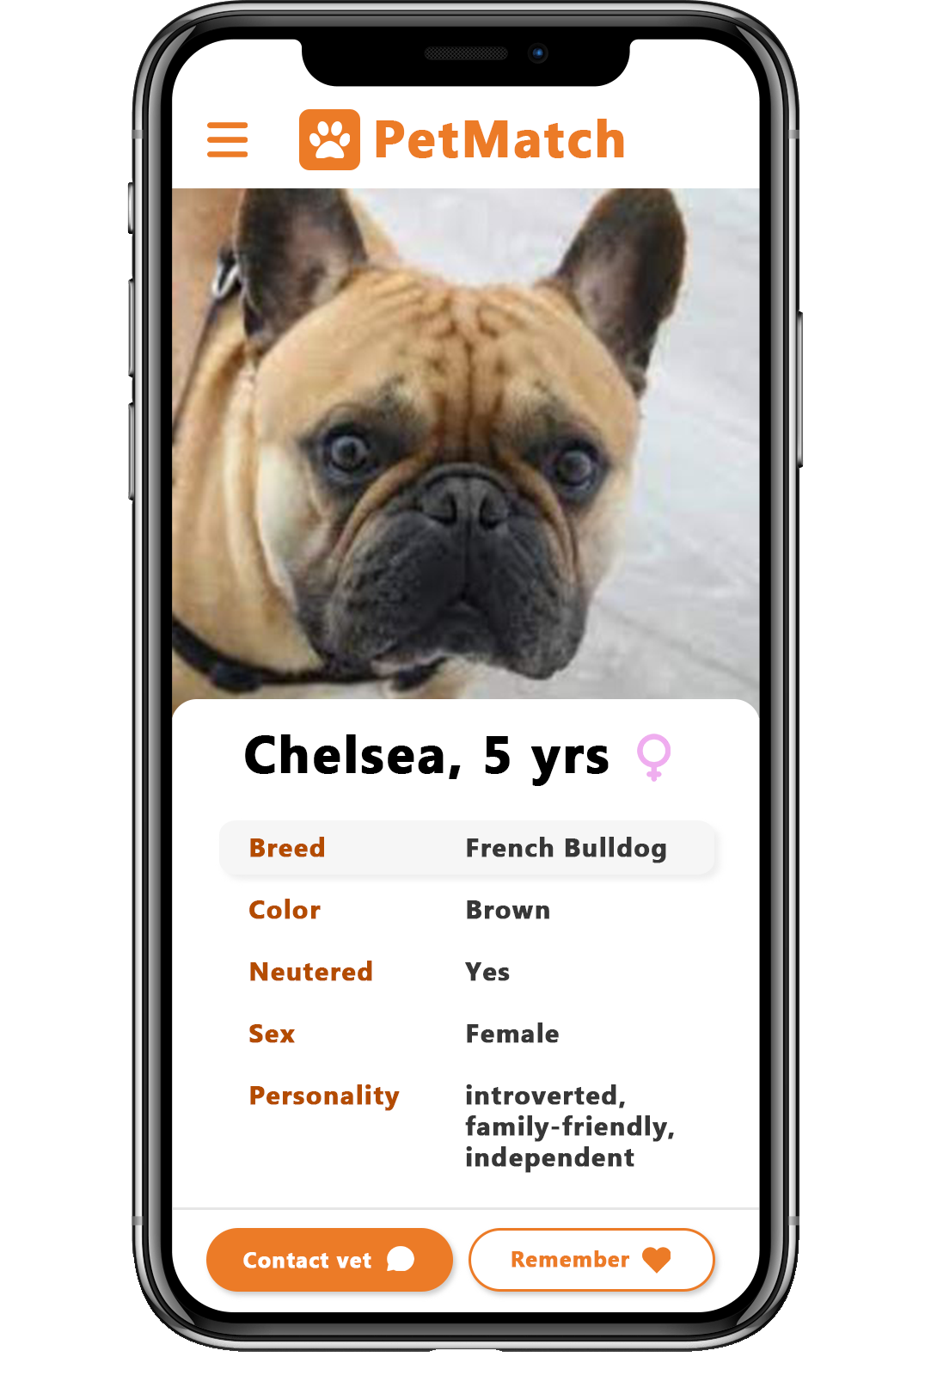
OUR SOLUTION

Slide 6
THE CODE
List as an Output
- The output is a dataframe of the closest matches in descending order.
- In the final dataframe result, the User can see additional information (e.g. species, personality etc.)
K-Nearest Neighbour
- We compare the User input data with the cleaned dataframe.
- We turned each animal attribute and the User input into int values and use the KNN-algorithm to calculate the closest match
Clean Data Frame
- We use an exemplatory data set of and turned it into a dataframe.
- We then cleaned the data so it is usable for our purposes.
Input User
Application asks user different questions regarding the desired animal and saves the user input in an array

Slide 7
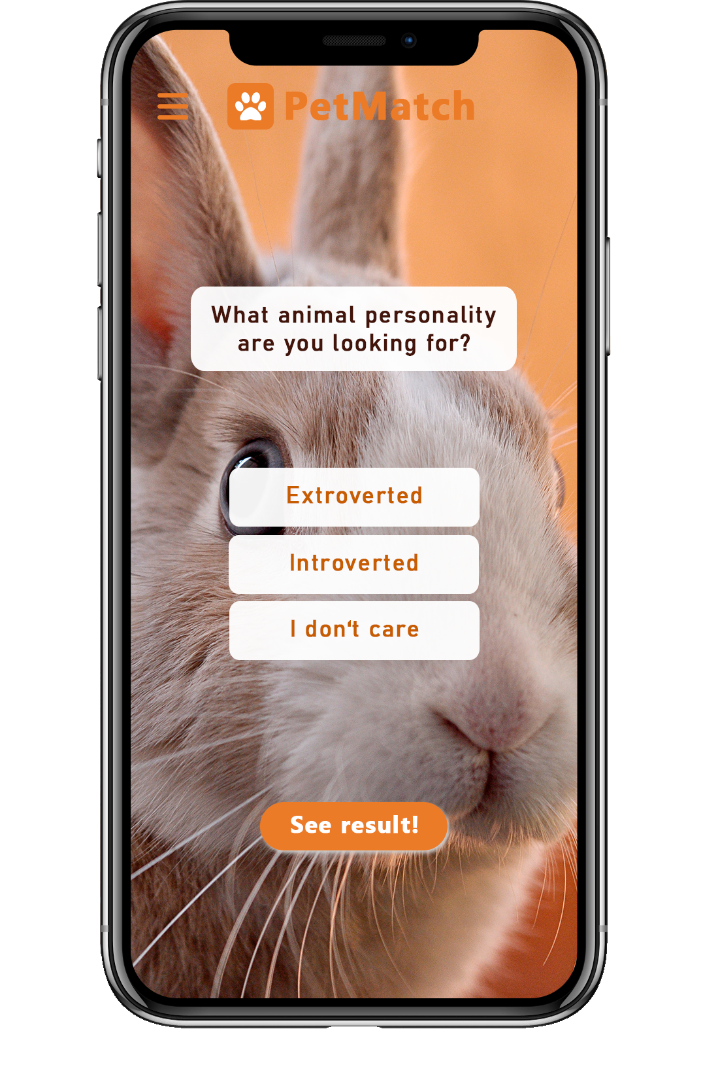
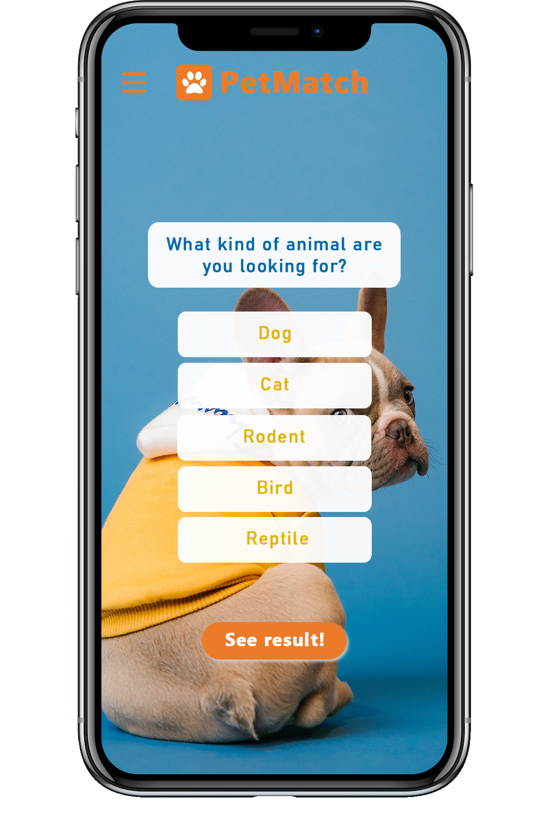
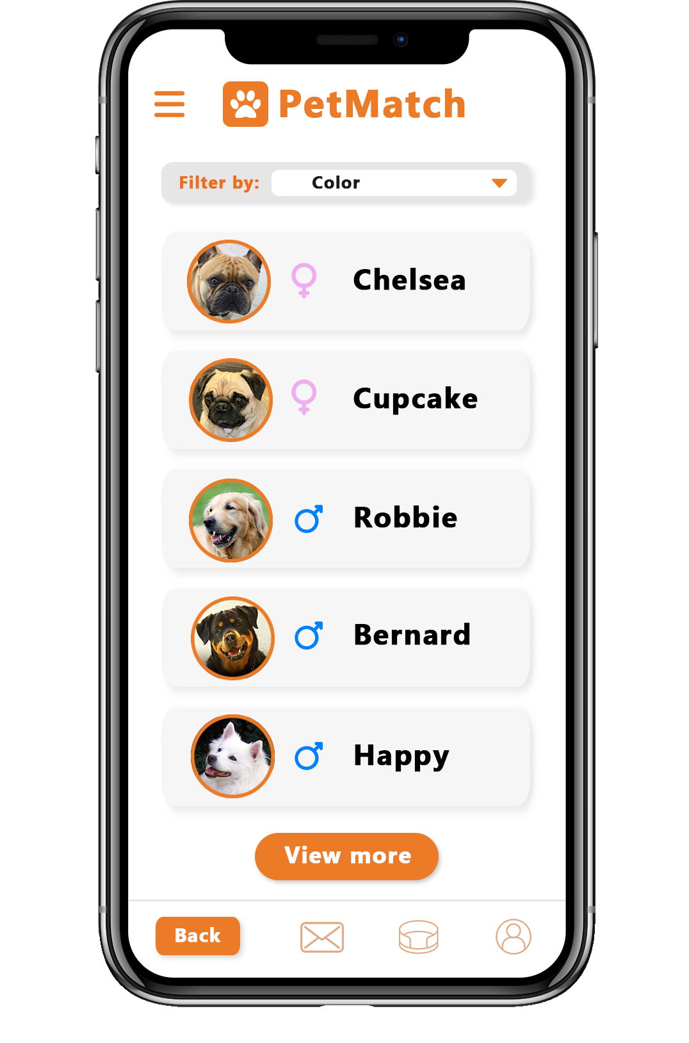
USER INPUT & OUTPUT

Slide 8
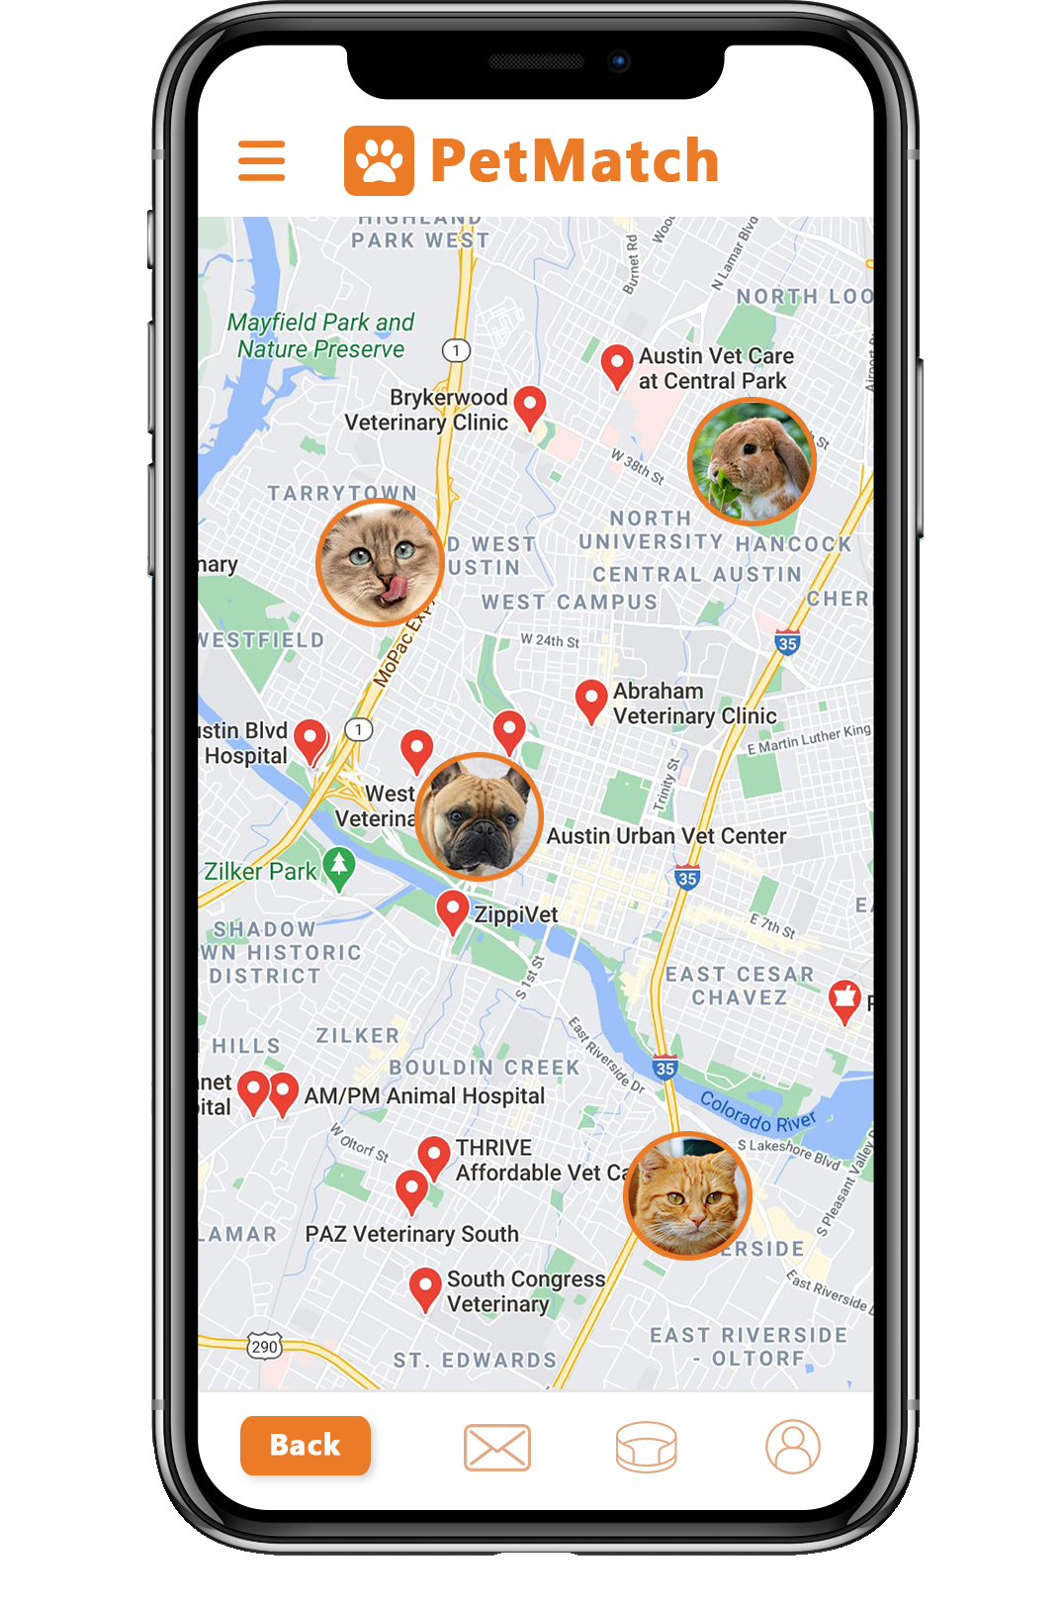
FUTURE FEATURES
allow a vet to register new pets to the DataFrame
Additional geographical filter: find the closest vet in your area

